Slide 1
Local Filtering and Edge Detection
Alessandro Giusti

Slide 2
Local filtering

Slide 3
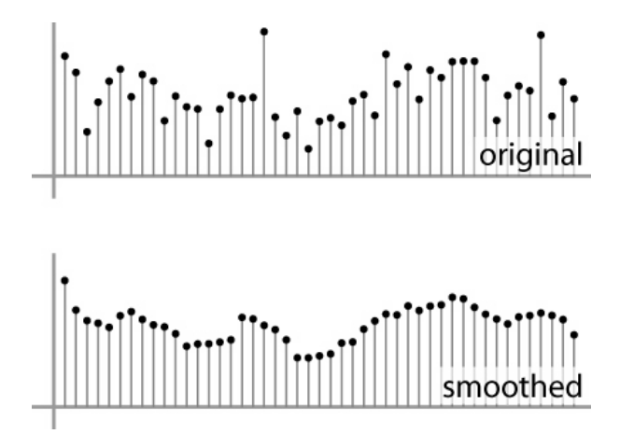
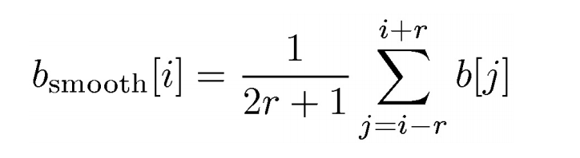
Simple filtering in 1D: moving average
Replace every value with the average of the pixels in its neighborhood
average
Slide credit: S. Marschner

Slide 4
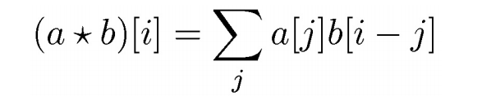
Convolution
A convolution is a weighted moving average
The sequence of weights a[j] is called filter or convolution kernel.
Slide credit: S. Marschner

Slide 5
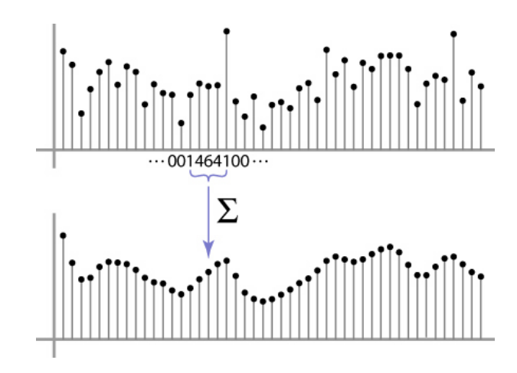
1D convolution example
Using a bell-shaped kernel a = [1, 4, 6, 4, 1] / 16

Slide 6
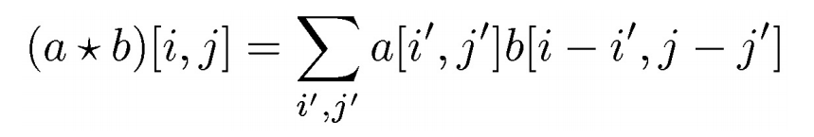

2D convolution
Same as 1D, with one more index
Now the filter is a rectangle you slide around over a grid of numbers
Output
Input

Slide 7
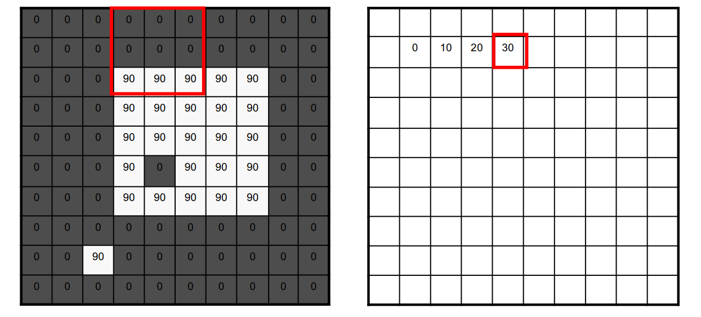
Example

Slide 8
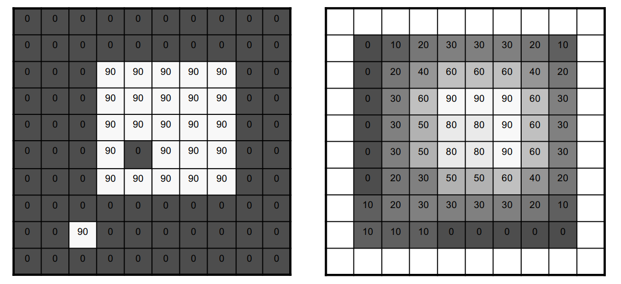
Example

Slide 9
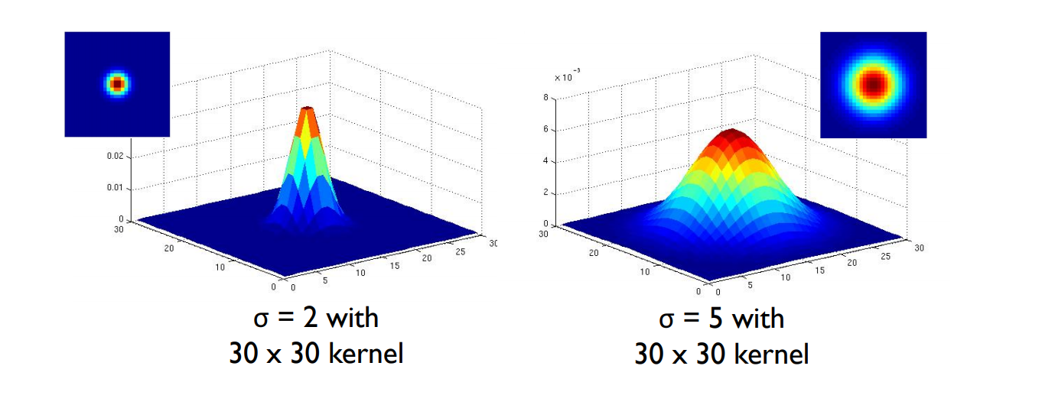
Smoothing with gaussian filters
Variance (sigma) determines the amount of smoothing

Slide 10
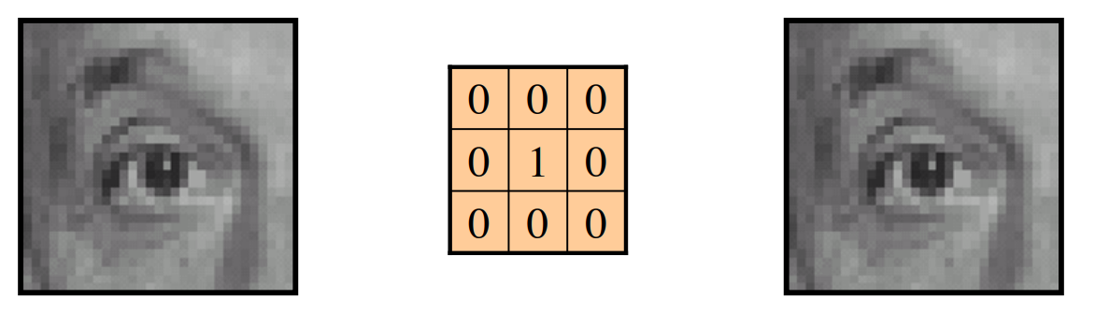
Example
Kernel
Original

Slide 11
Example
Kernel
Original
same as original

Slide 12
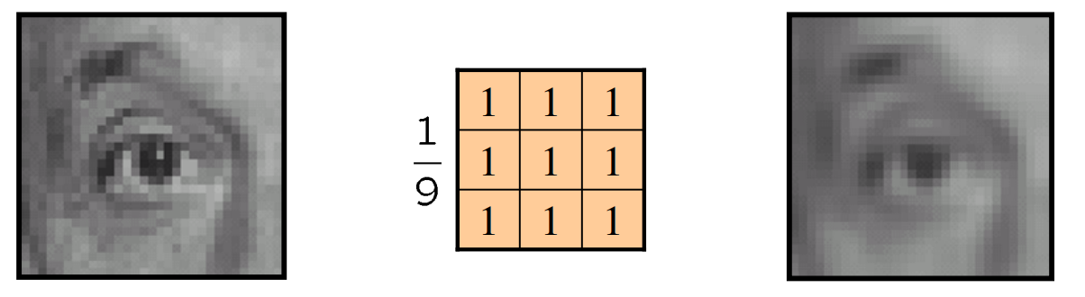
Example
Original
Kernel

Slide 13
Example
Original
Kernel
smoothed

Slide 14
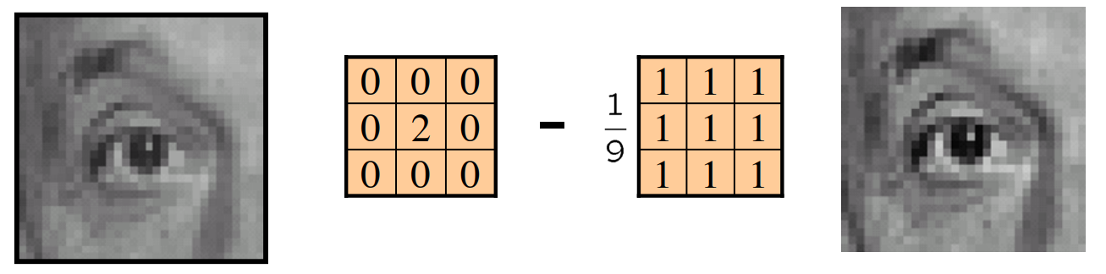
Example
Kernel
Original

Slide 15
Example
Kernel
sharpened
Original

Slide 16
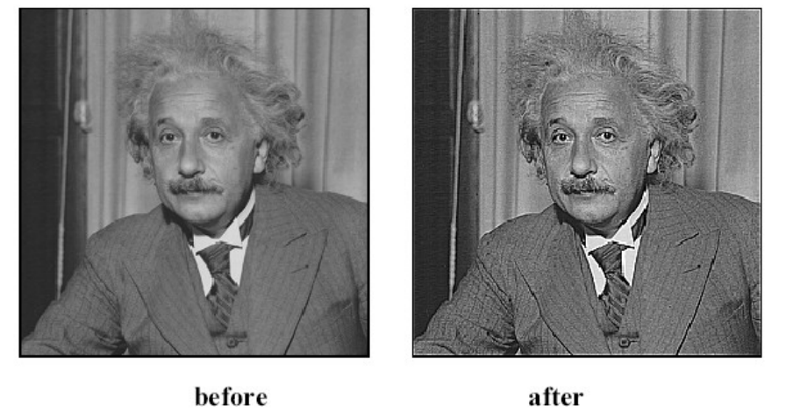
Sharpening

Slide 17
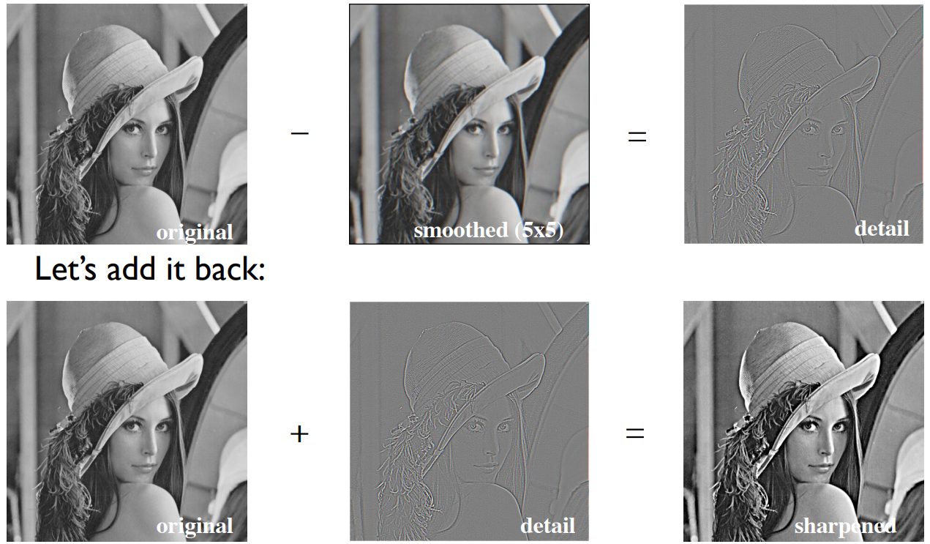
Why does sharpening work?

Slide 18
Edge detection

Slide 19
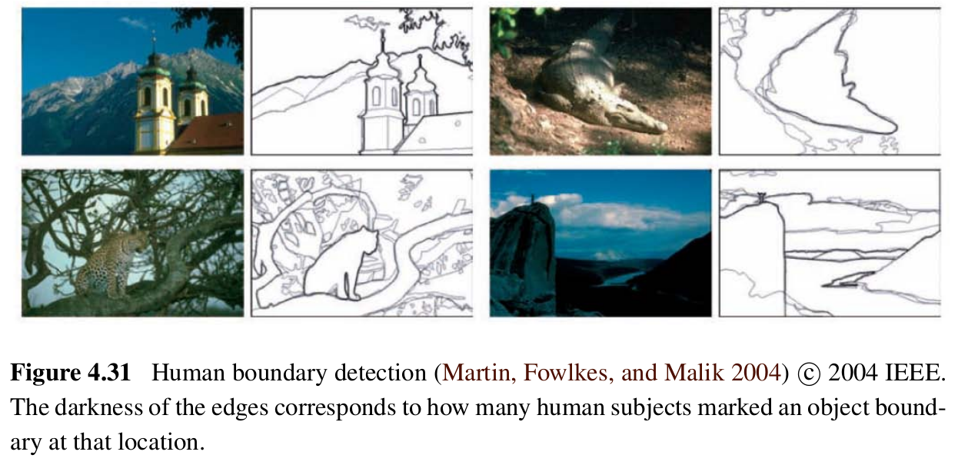
Edges are important features when we look at images!
Szelinski: Computer Vision: theory and Applications

Slide 20
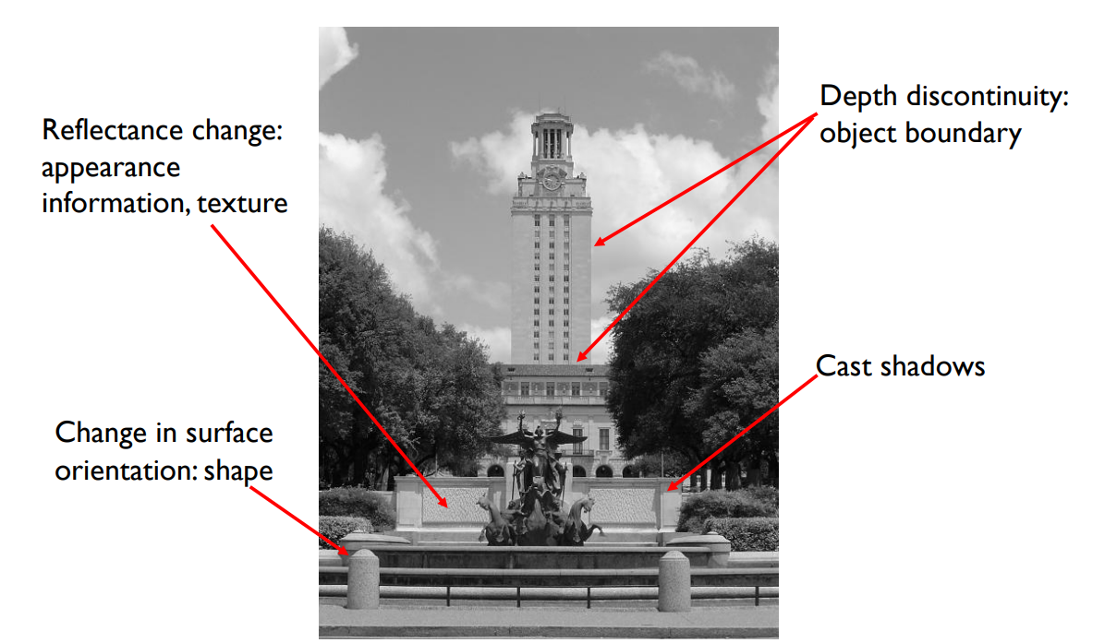
Causes of edges
Slide credit: K. Grauman

Slide 21
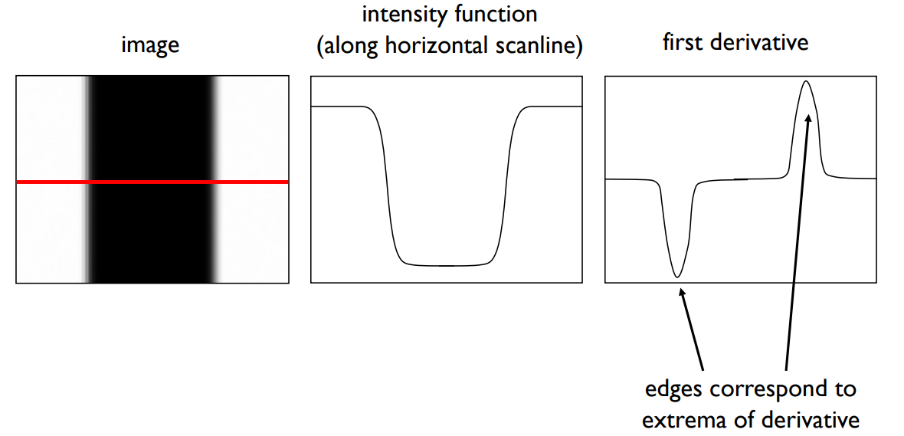
What is an edge?
Rapid changes in intensity (edges)
Slide credit: K. Grauman

Slide 22
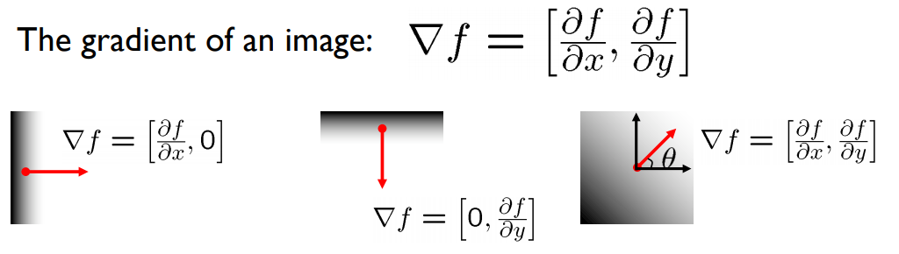
In 2D...
In 2D, the derivative corresponds to the gradient
The gradient is a vector defined for every point in the image
It points to the direction of most rapid increase of the intensity
Slide credit: S. Seitz

Slide 23
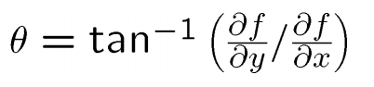
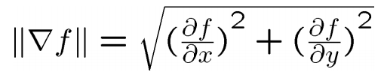
Gradient direction and strength
Gradient direction (orthogonal to the edge):
Gradient magnitude (strength of the edge):
Slide credit: S. Seitz

Slide 24
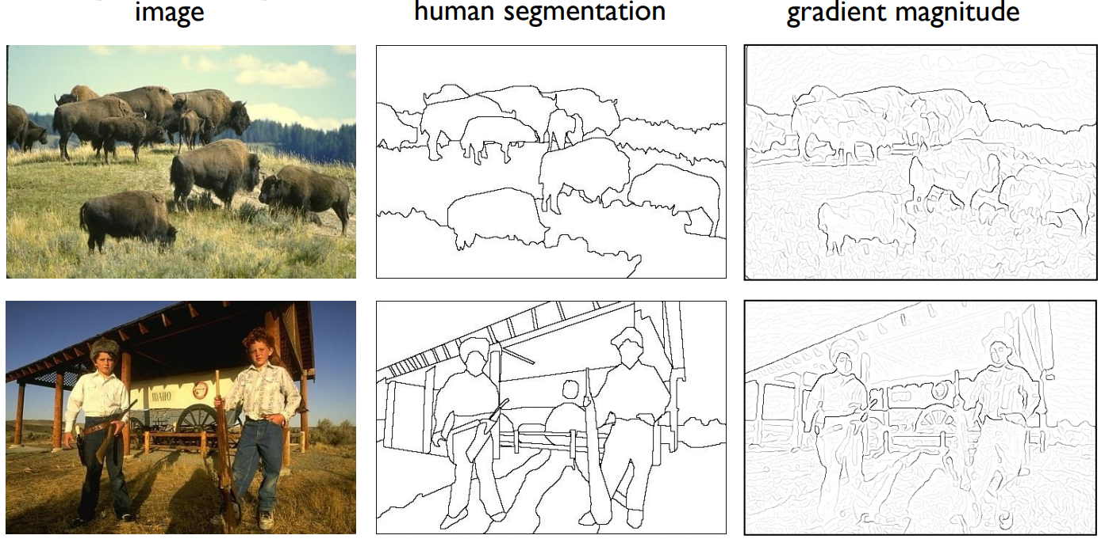
Keep in mind:
Not all important edges have strong gradients
Not all strong gradients are important edges

Slide 25
Computing the gradient on an image
How do we approximate ?
How do we approximate ?

Slide 26
Computing the gradient on an image
How do we approximate ?
How do we approximate ?
Finite differencing!
convolve with
convolve with
-1
1
-1
1

Slide 27
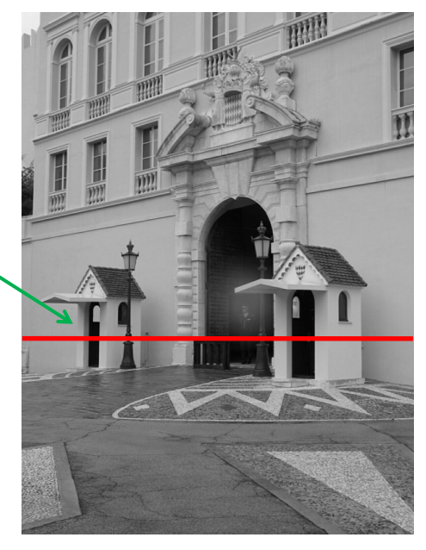
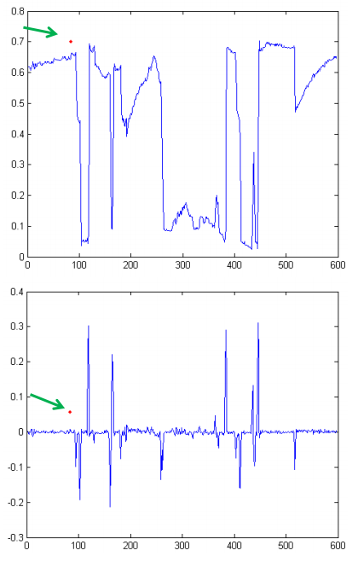
Example of finite differencing
Intensity along profile
Horizontal gradient
peaks are clearly visible

Slide 28
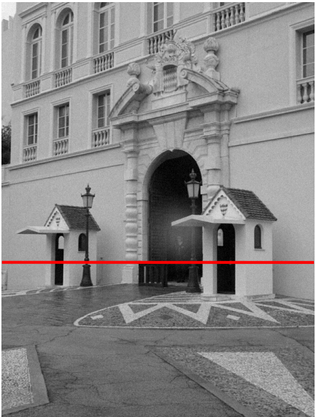
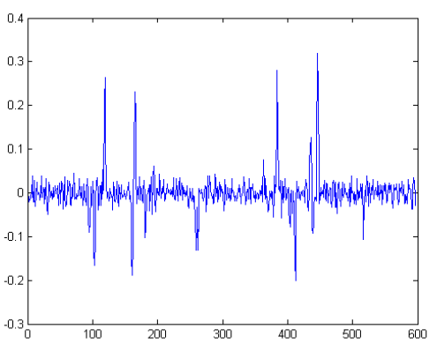
If we add a tiny amount of noise to the image...
Horizontal gradient
smaller peaks are lost in the noise
Slide credit: D. Hoiem

Slide 29
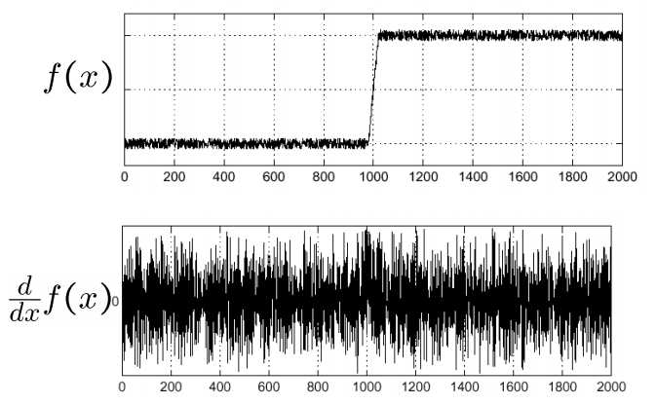
Another 1D example
Where is the edge?!?
Slide credit: S. Seitz

Slide 30
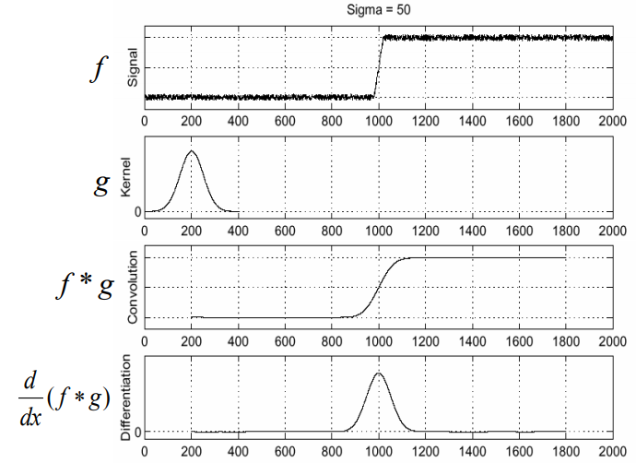
Solution: smooth, then compute gradient

Slide 31
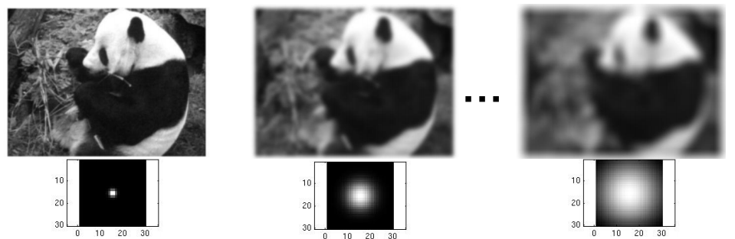
Different amounts of smoothing...
Amount of smoothing depends on the value of sigma (width of the gaussian)
Slide credit: K. Grauman

Slide 32
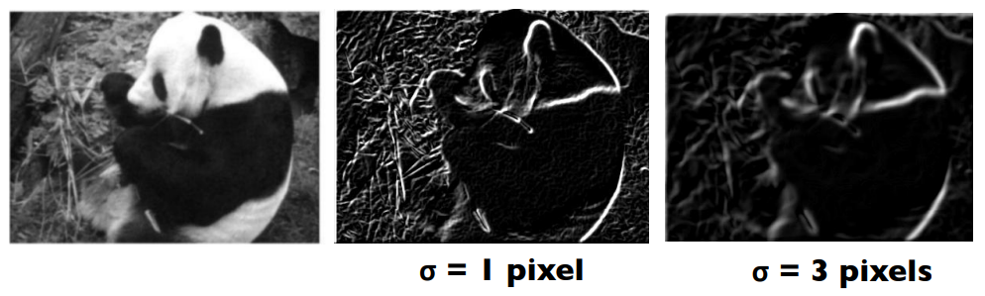
.... show different structures in the gradients
Larger values of sigma: larger scale edges detected
Smaller values of sigma: finer details detected
Slide credit: K. Grauman

Slide 33
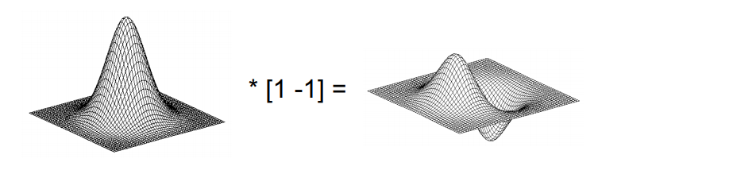
In practice
To compute gradients, convolve with a derivative-of-gaussian filter.
This is equivalent to smoothing with a gaussian and then taking the derivative.
Slide credit: S. Lazebnik

Slide 34
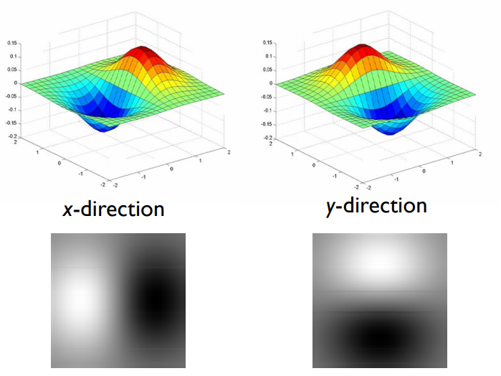
Derivative-of-gaussian filters
Slide credit: S. Lazebnik

Slide 35
Notes
Gaussian smoothing filter
removes “high-frequency” components
values sum to one
Derivative filters
contain some negative values
values sum to 0
yield large responses at points with high contrast (e.g. edges)

Slide 36
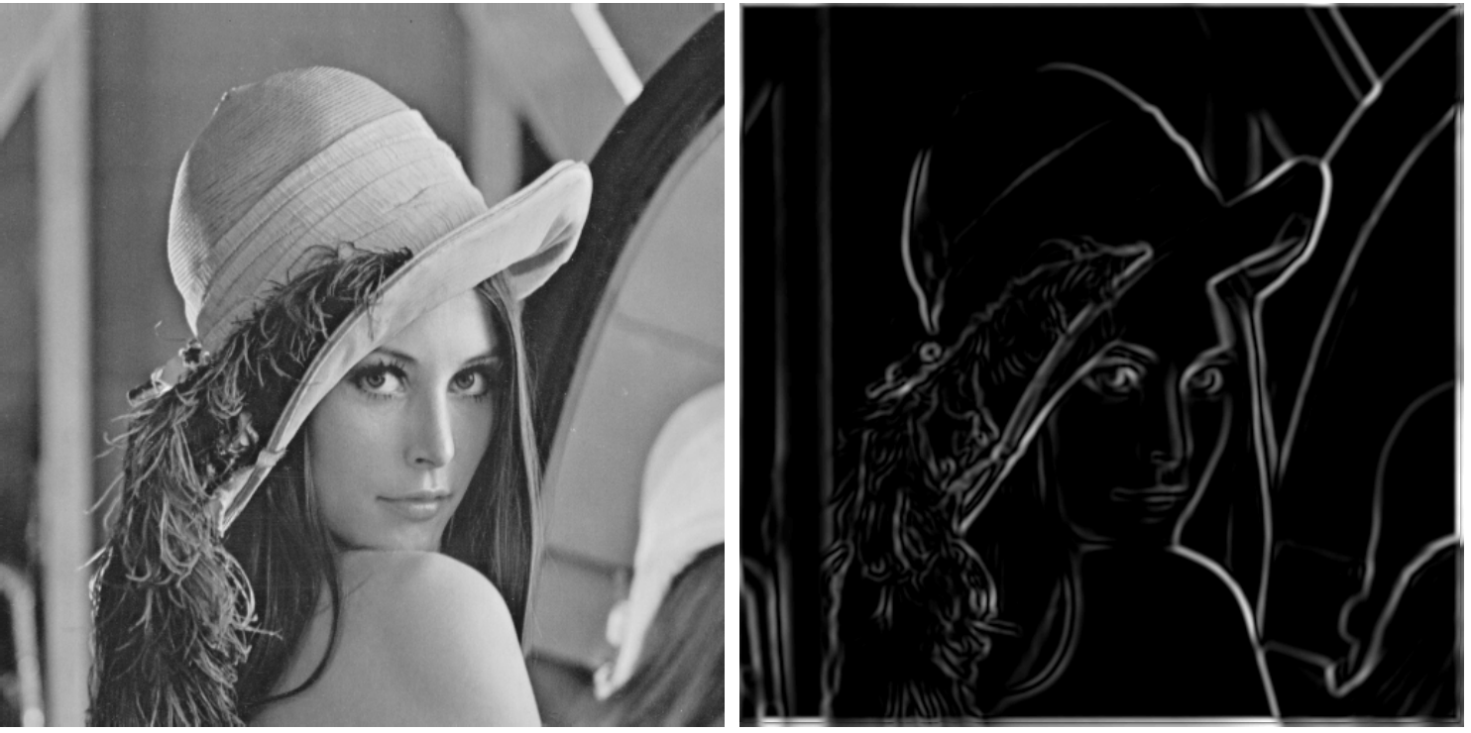
Edge detection summary
Approximate gradients along x and y by convolving with derivative-of-gaussian filters
Compute gradient magnitude as

Slide 37
Canny edge detection algorithm
Approximate gradients along x and y by convolving with derivative-of-gaussian filters
Compute gradient magnitude as
Make edges 1-pixel-wide (thinning):
non-maxima suppression along perpendicular direction to edge, i.e. direction of gradient
Only keep strong edges
hysteresis thresholding

Slide 38

Non-maxima suppression
Intuitively:
of all the possible edge pixels along the line... keep only this one
... then repeat along the whole edge. Results in thinning the edge to a 1-pixel width

Slide 39
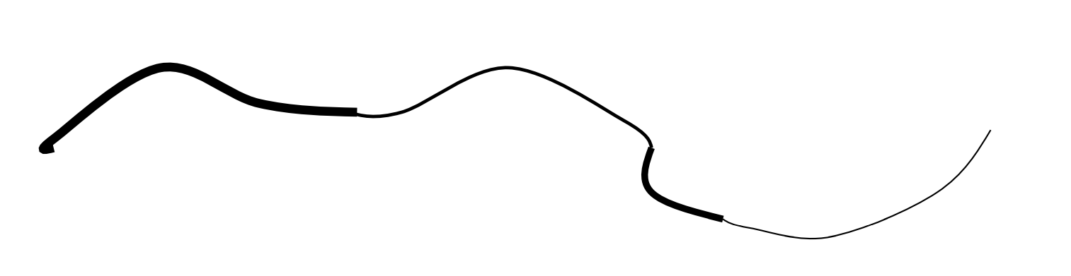
Hysteresis thresholding
Intuitively: Use a high threshold to start curves and a low threshold to continue them
the edge here is weak,
but it is kept because it is connected to a strong edge
this edge is weak
and is rejected because
it is not connected to any strong edge

Slide 40
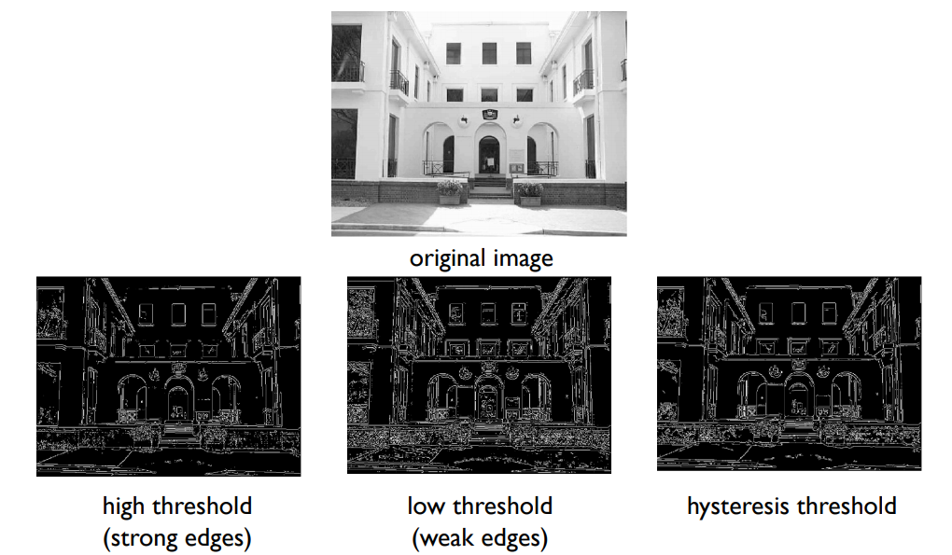
Slide credit: L. Fei-Fei

Slide 41
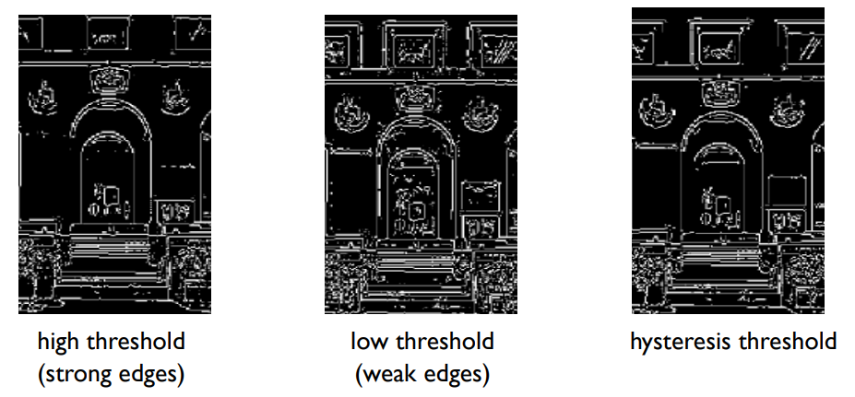
Slide credit: L. Fei-Fei

Slide 42
Slide credit: L. Fei-Fei

Slide 43
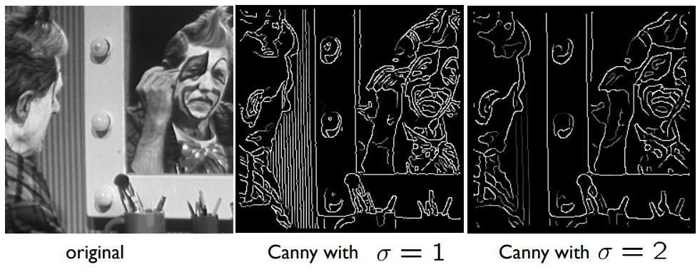
Effect of gaussian sigma

Slide 44
